Slide 1




Aesthetic-based Clothing Recommendation
我们毕业啦
其实是答辩的标题地方
Wenhui Yu¹ Huidi Zhang¹ Xiangnan He² Xu Chen¹ Li Xiong³ Zheng Qin¹
1. School of Software, Tsinghua University
2. School of Computing, National University of Singapore
3. Department of Mathematics and Computer Science, Emory University

Slide 2
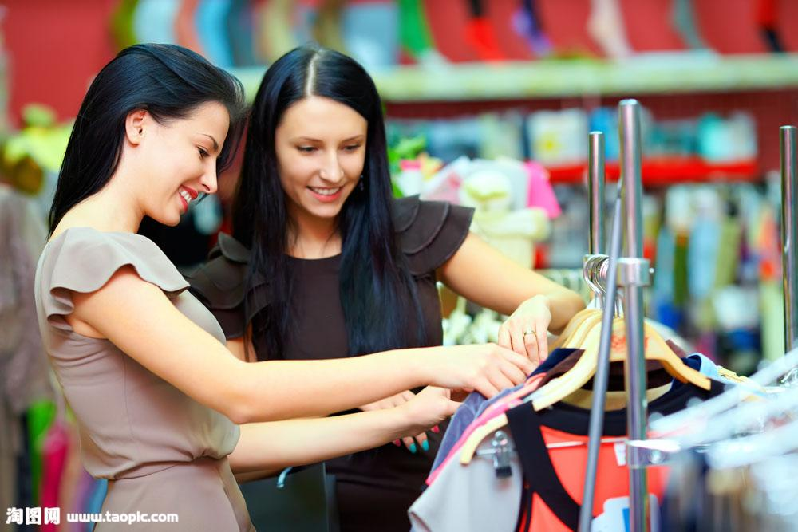
Background
Aesthetic Network
Basic Model
Hybrid Model
Experiments
Conclusion
When purchasing clothes with women...

Slide 3
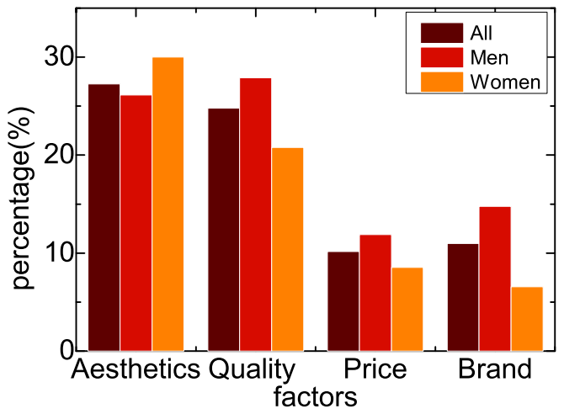
Background
Aesthetic Network
Basic Model
Hybrid Model
Experiments
Conclusion

Slide 4
Background
Aesthetic Network
Basic Model
Hybrid Model
Experiments
Conclusion
Aesthetic is the most important factor when making decision

Slide 5
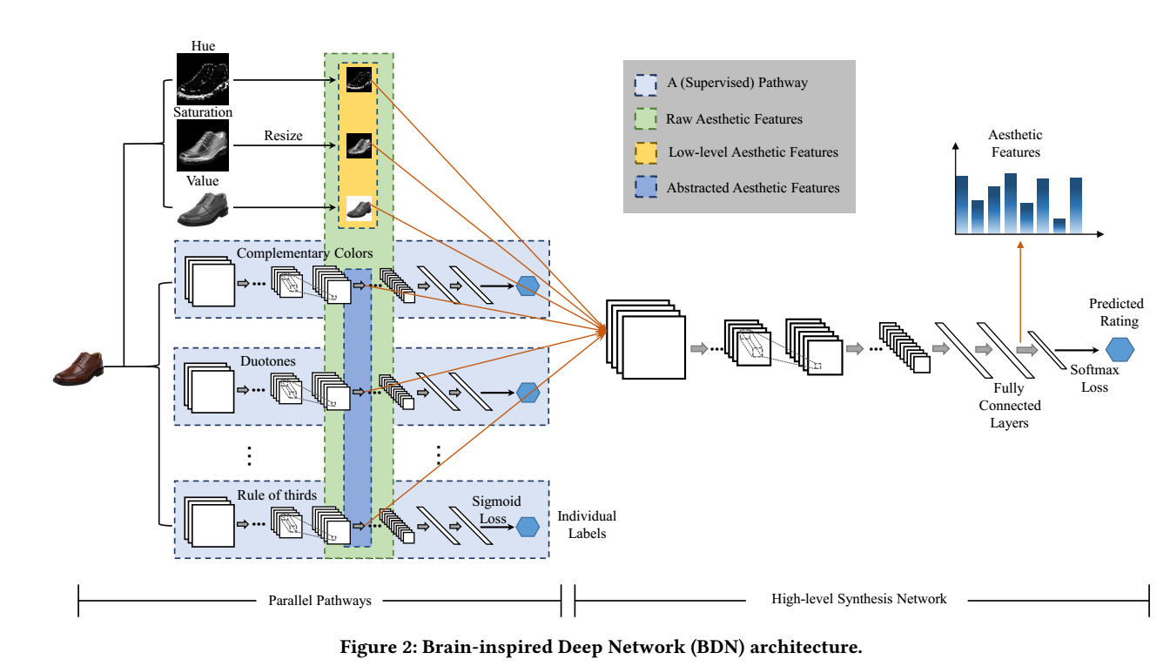
Background
Aesthetic Network
Basic Model
Hybrid Model
Experiments
Conclusion
Parallel pathway
High-level sythesis network
Brain-inspired deep network

Slide 6
Background
Aesthetic Network
Basic Model
Hybrid Model
Experiments
Conclusion
Parallel pathway
High-level sythesis network
Brain-inspired deep network

Slide 7
Background
Aesthetic Network
Basic Model
Hybrid Model
Experiments
Conclusion
Parallel pathway
High-level sythesis network
Brain-inspired deep network

Slide 8
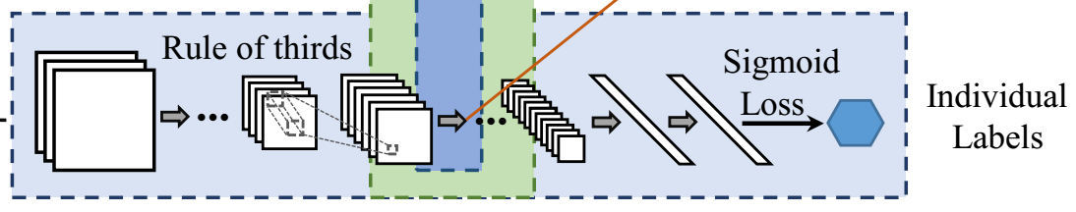
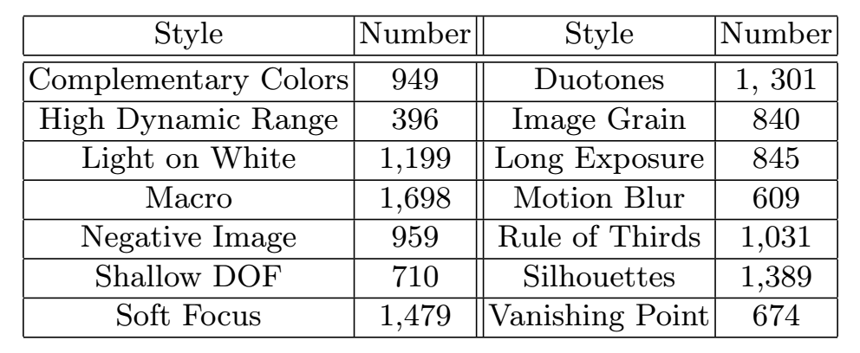
Background
Aesthetic Network
Basic Model
Hybrid Model
Experiments
Conclusion
A parellel pathway
14 style tags

Slide 9
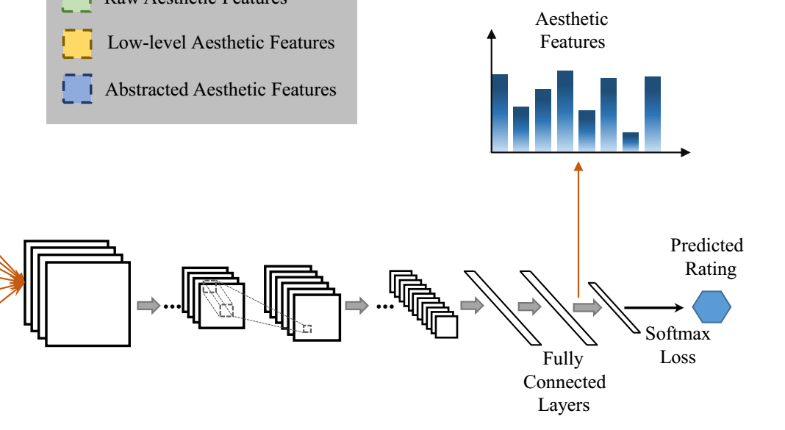
Background
Aesthetic Network
Basic Model
Hybrid Model
Experiments
Conclusion
The high-level synthesis network

Slide 10
Background
Aesthetic Network
Basic Model
Hybrid Model
Experiments
Conclusion
The high-level synthesis network
Raw features

Slide 11
Background
Aesthetic Network
Basic Model
Hybrid Model
Experiments
Conclusion
The high-level synthesis network
High-level
aesthetic
features
Raw features

Slide 12
Background
Aesthetic Network
Basic Model
Hybrid Model
Experiments
Conclusion
Parallel pathway
High-level sythesis network
Brain-inspired deep network

Slide 13
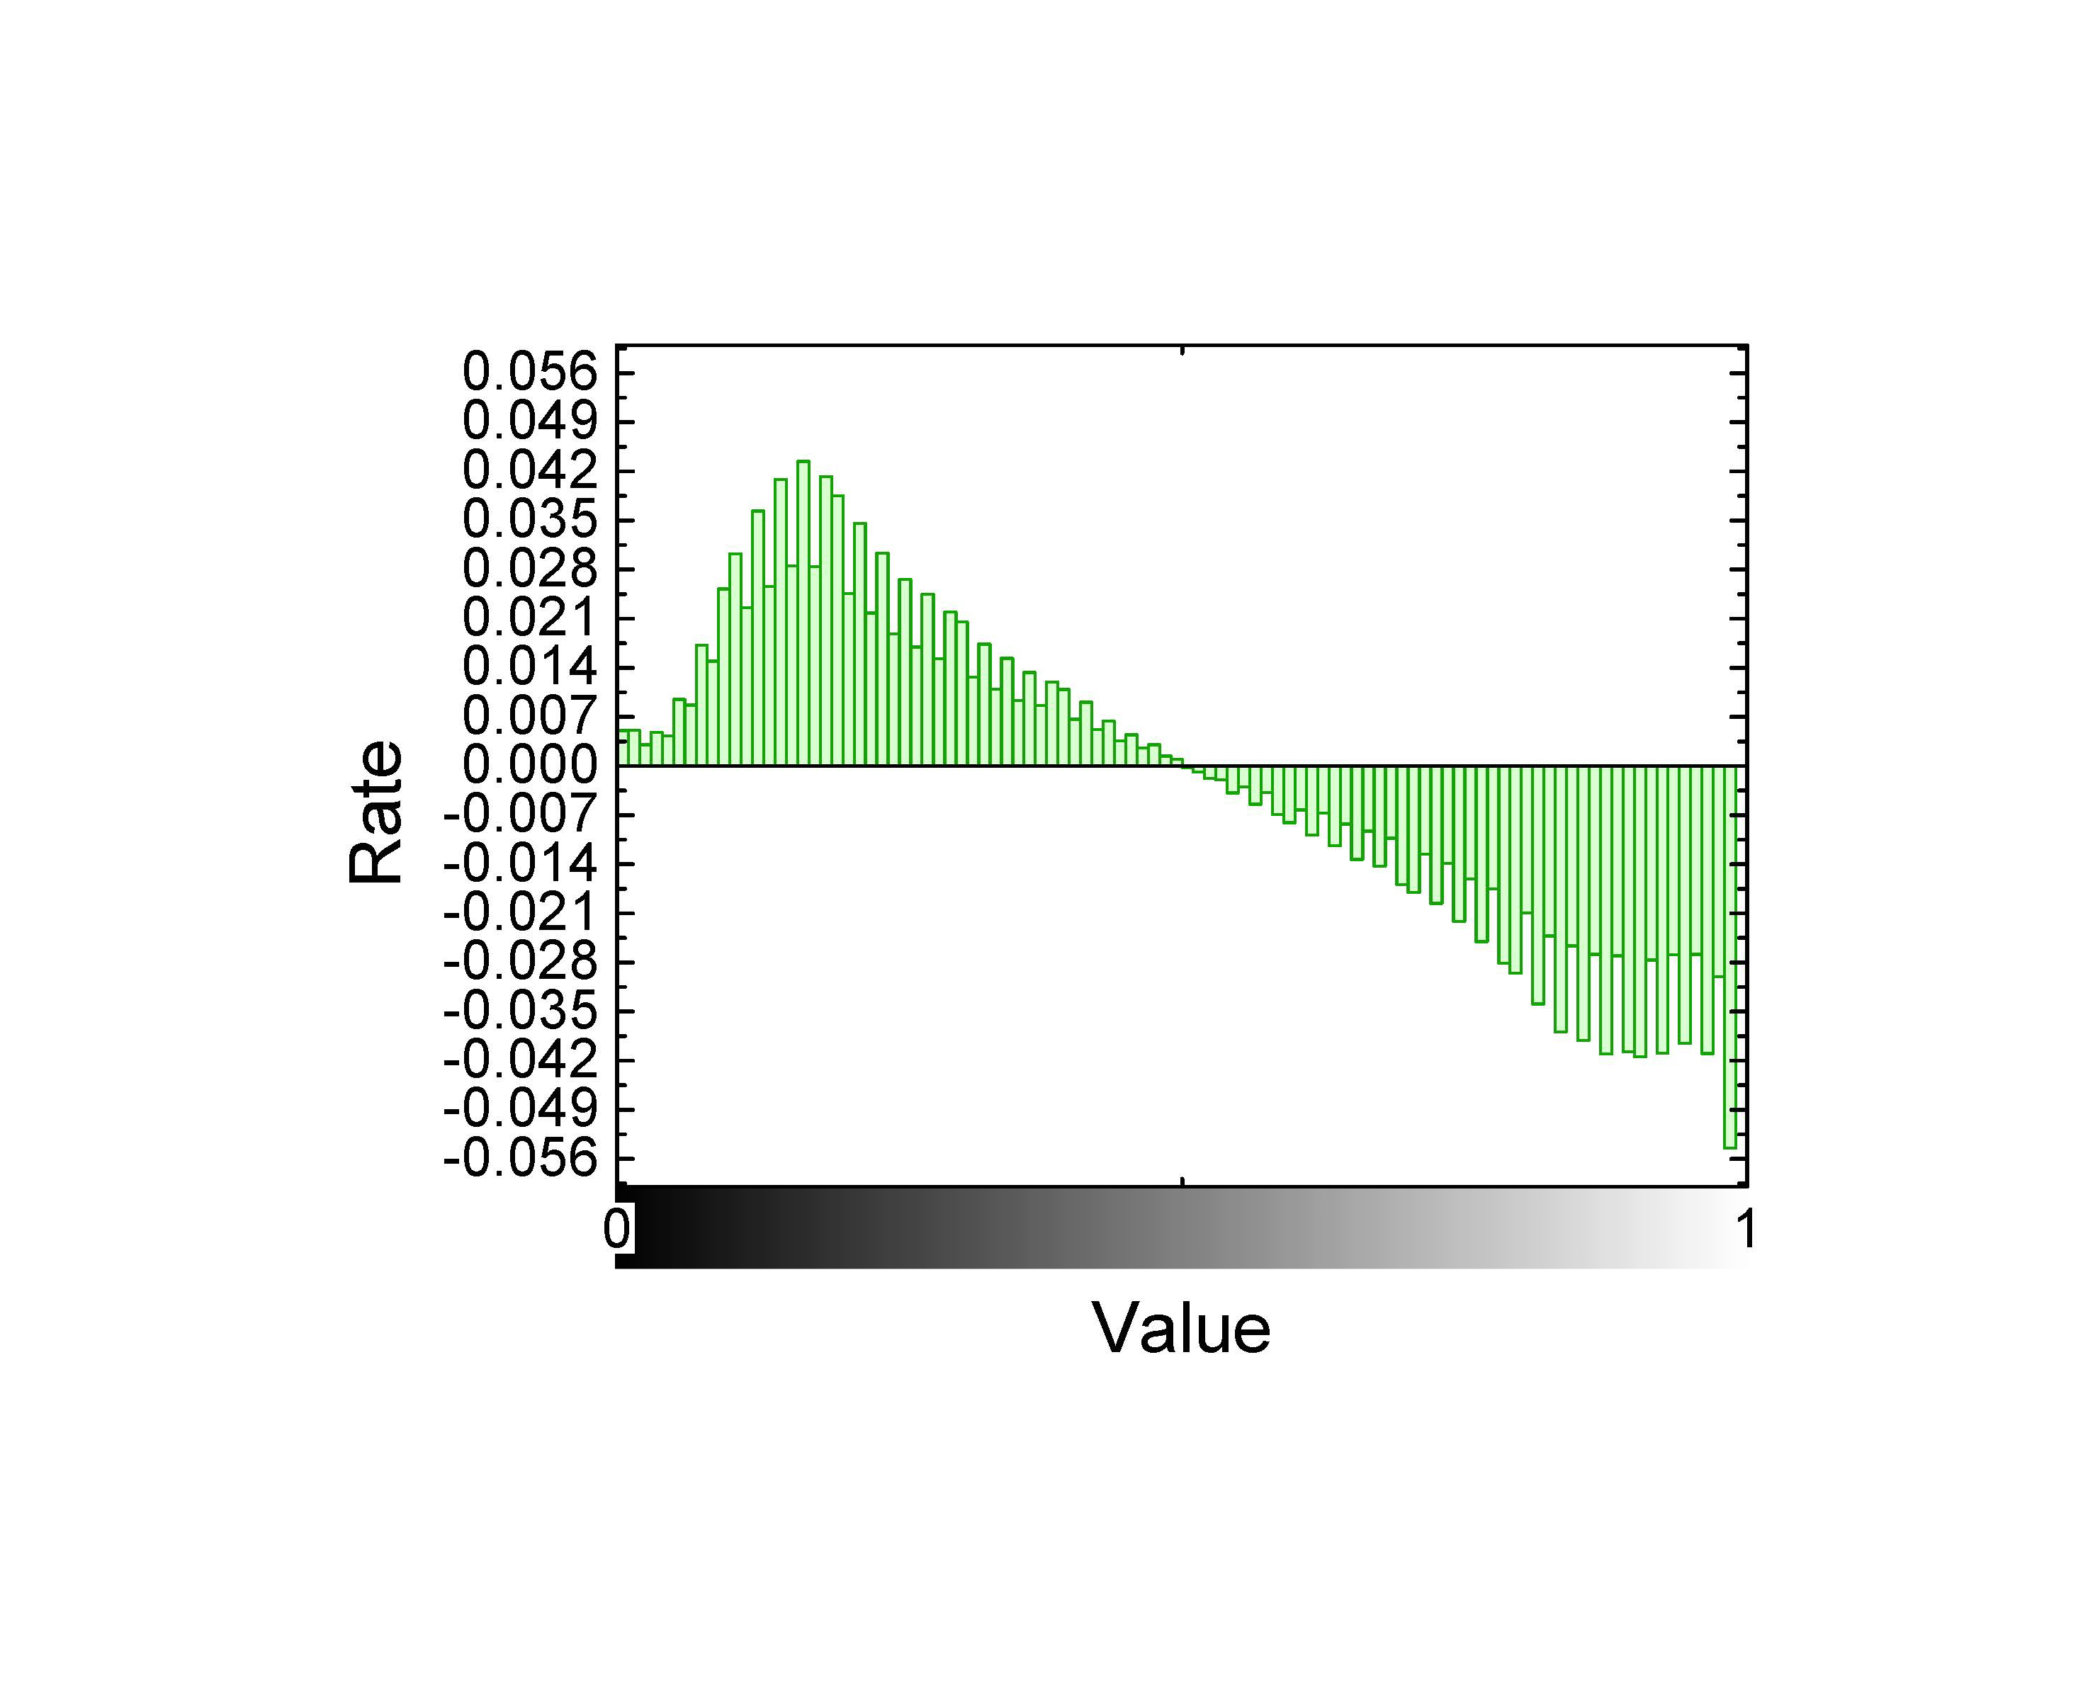
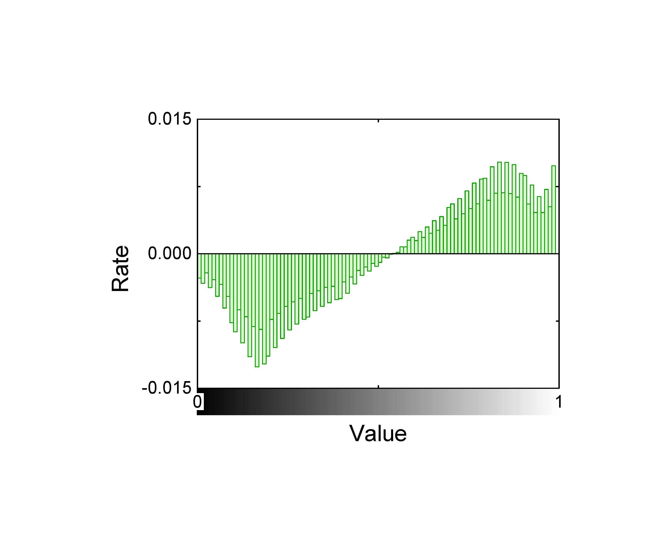
Background
Aesthetic Network
Basic Model
Hybrid Model
Experiments
Conclusion
Aesthetic preference with different gender
Men Women
prefer dark clothes prefer bright clothes

Slide 14
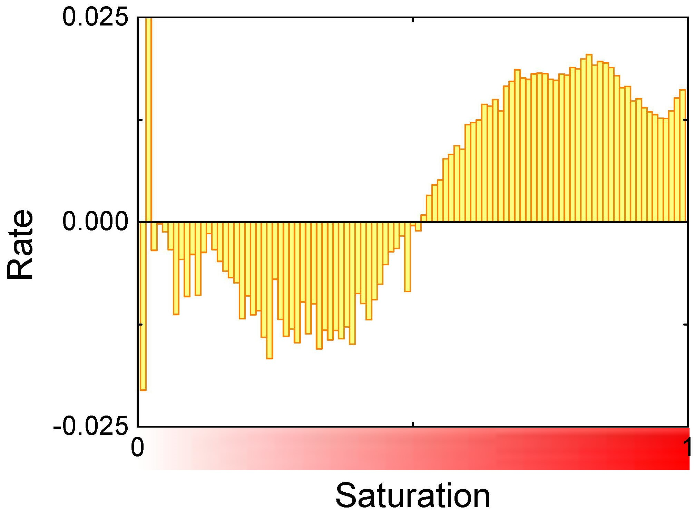
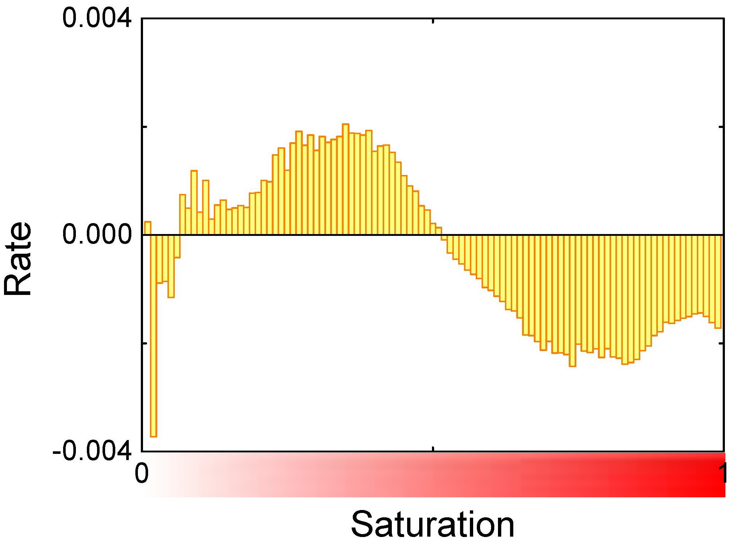
Background
Aesthetic Network
Basic Model
Hybrid Model
Experiments
Conclusion
Aesthetic preference with different age
Kids Adults
prefer colorful clothes prefer low saturation

Slide 15
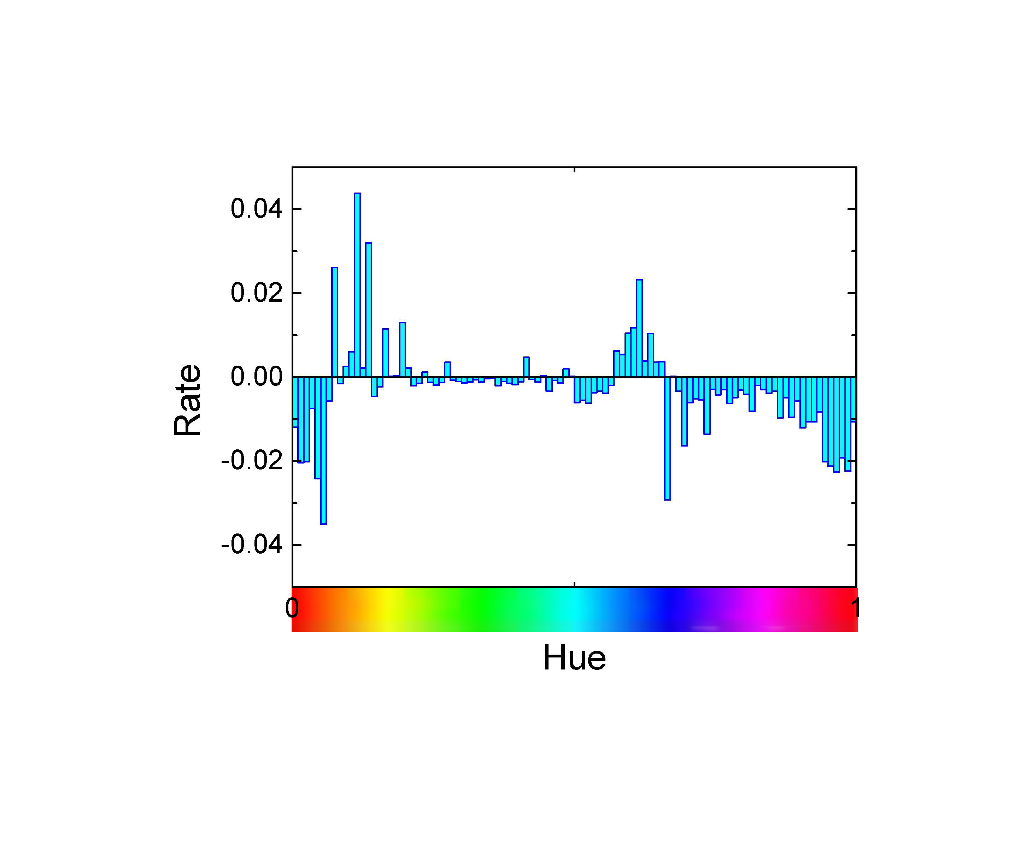
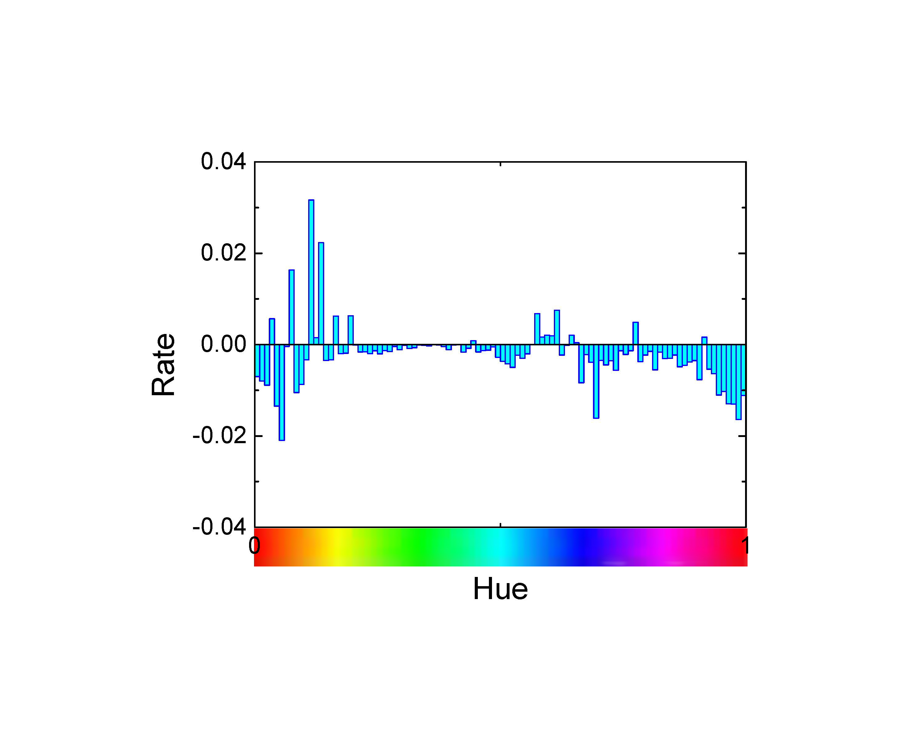
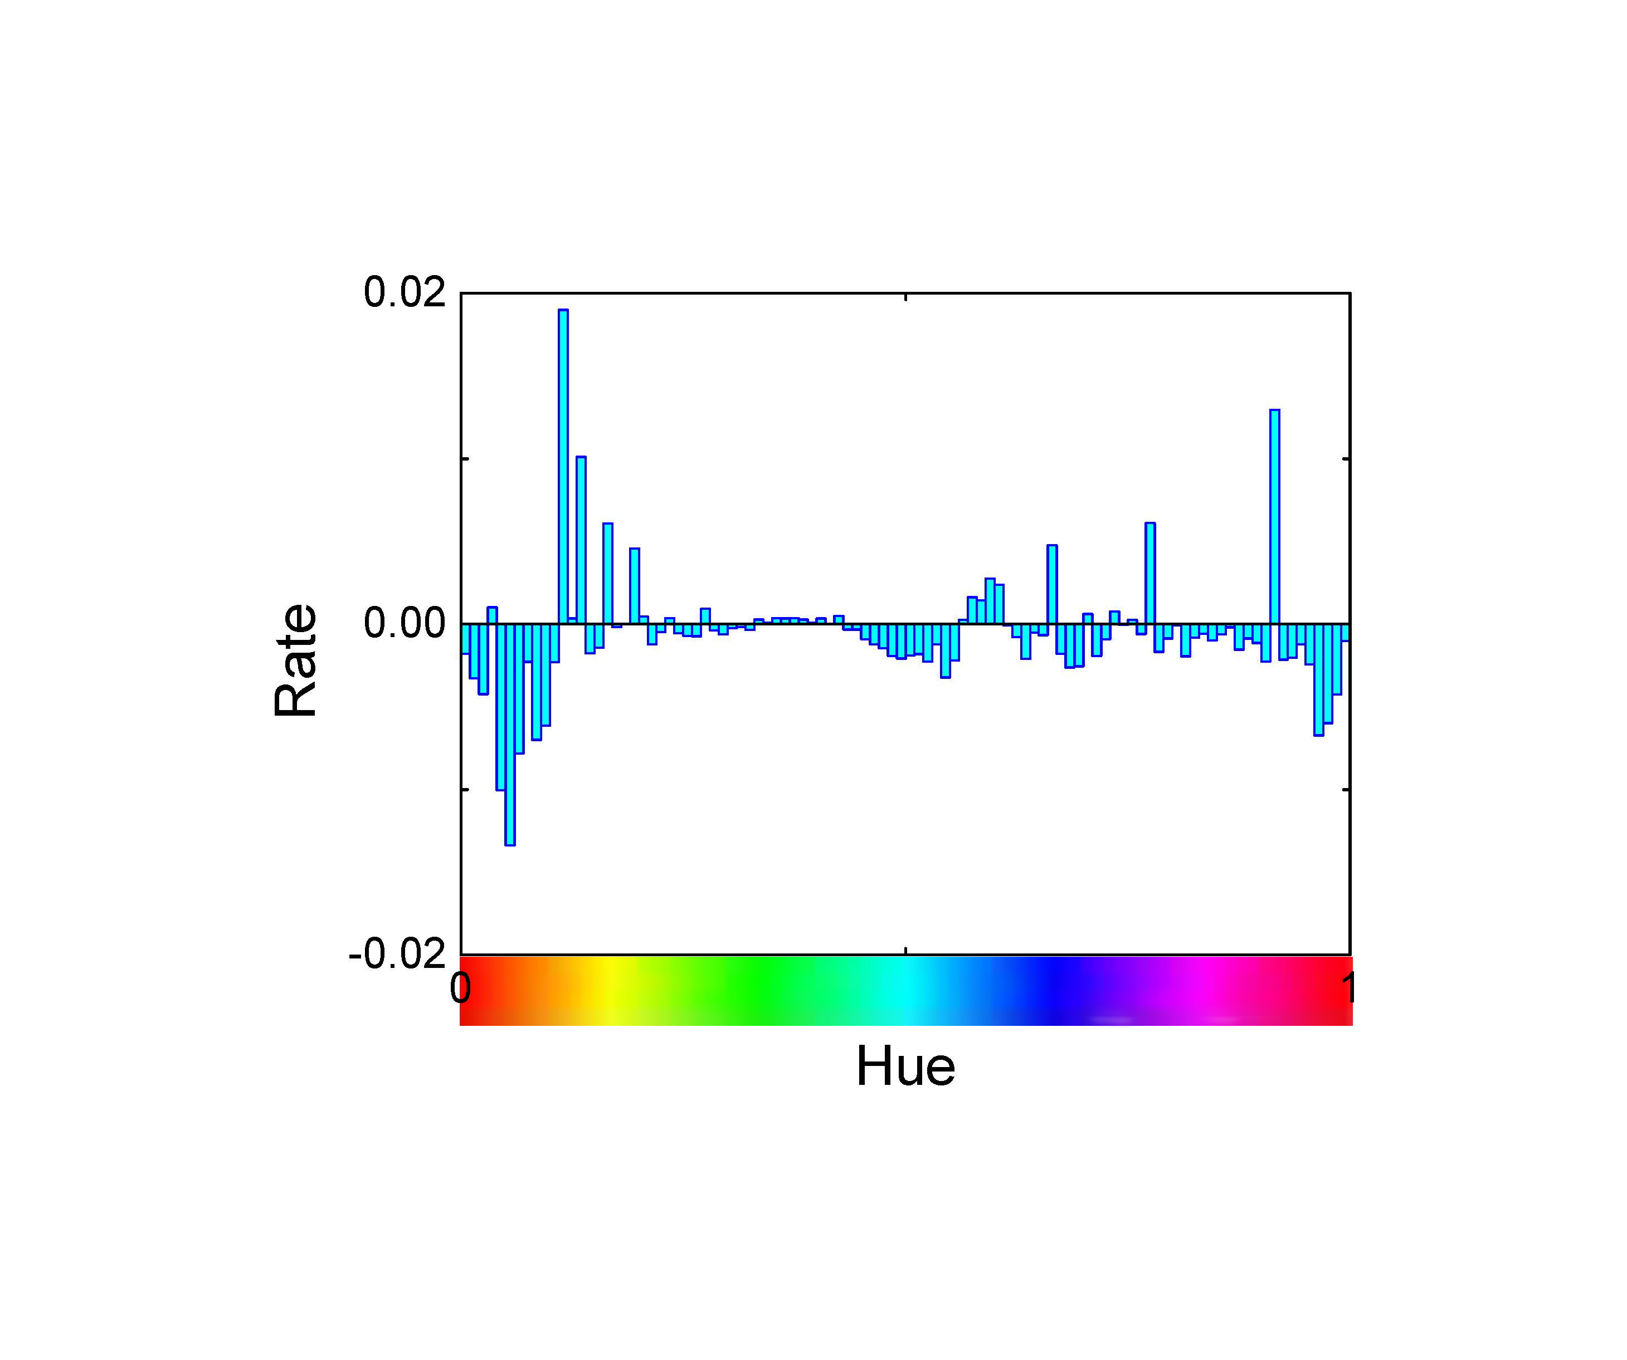
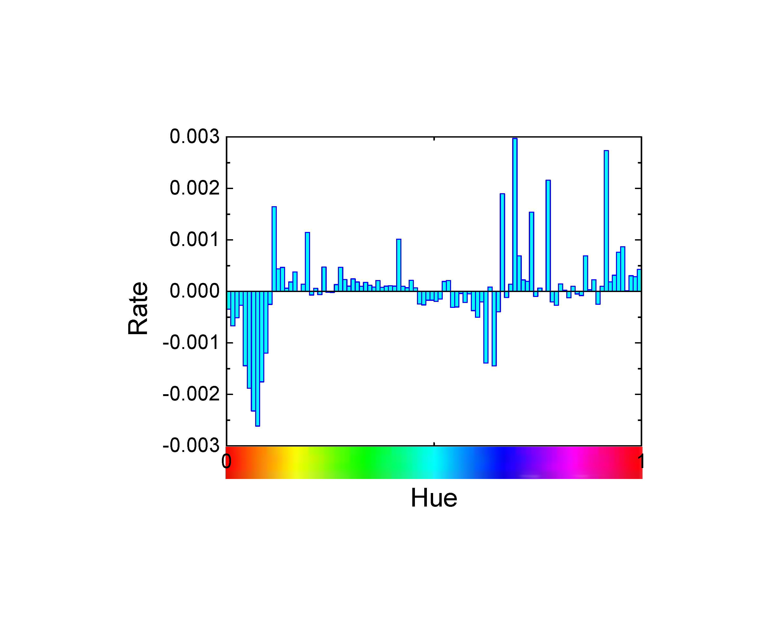
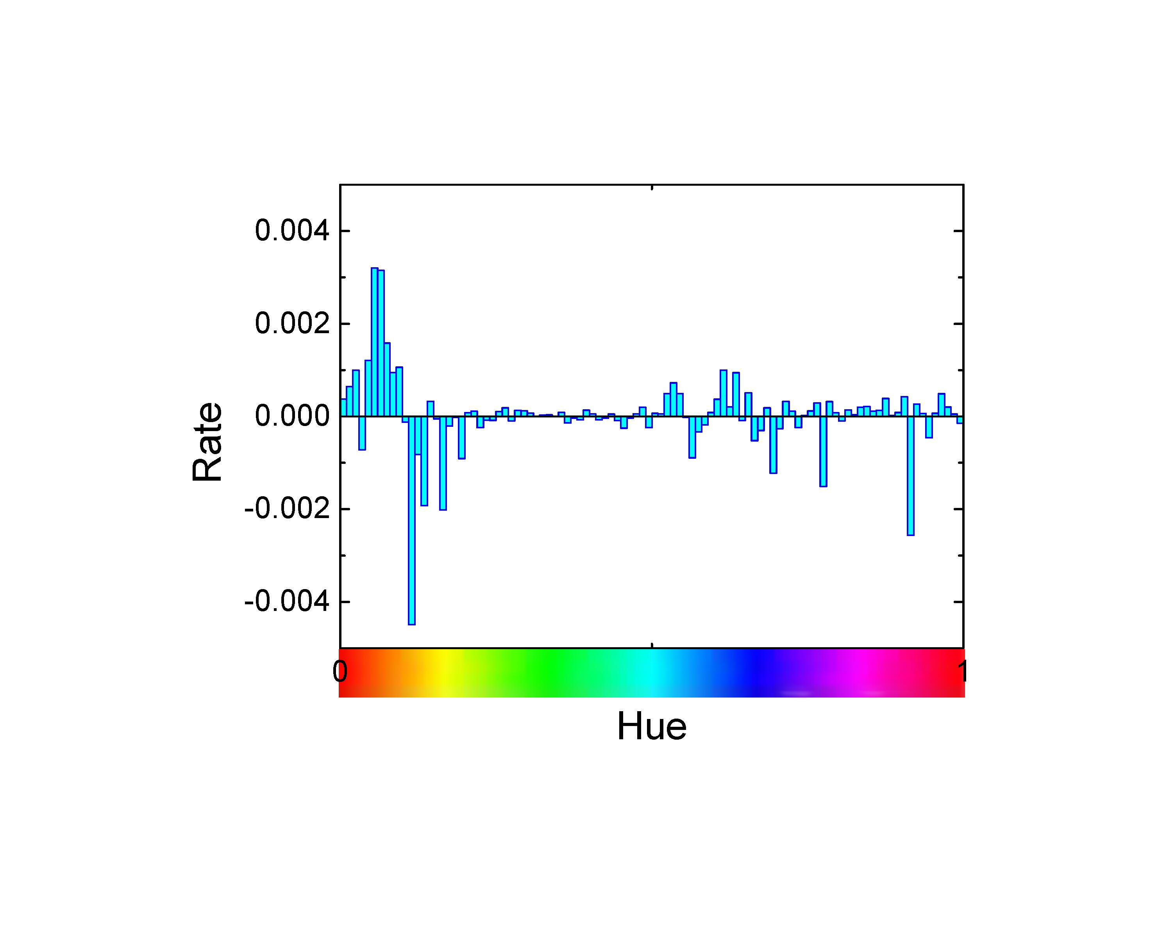
Background
Aesthetic Network
Basic Model
Hybrid Model
Experiments
Conclusion
Aesthetic preference with different time
2010 2011 2012 2013 2014
The popular color changes every year

Slide 16
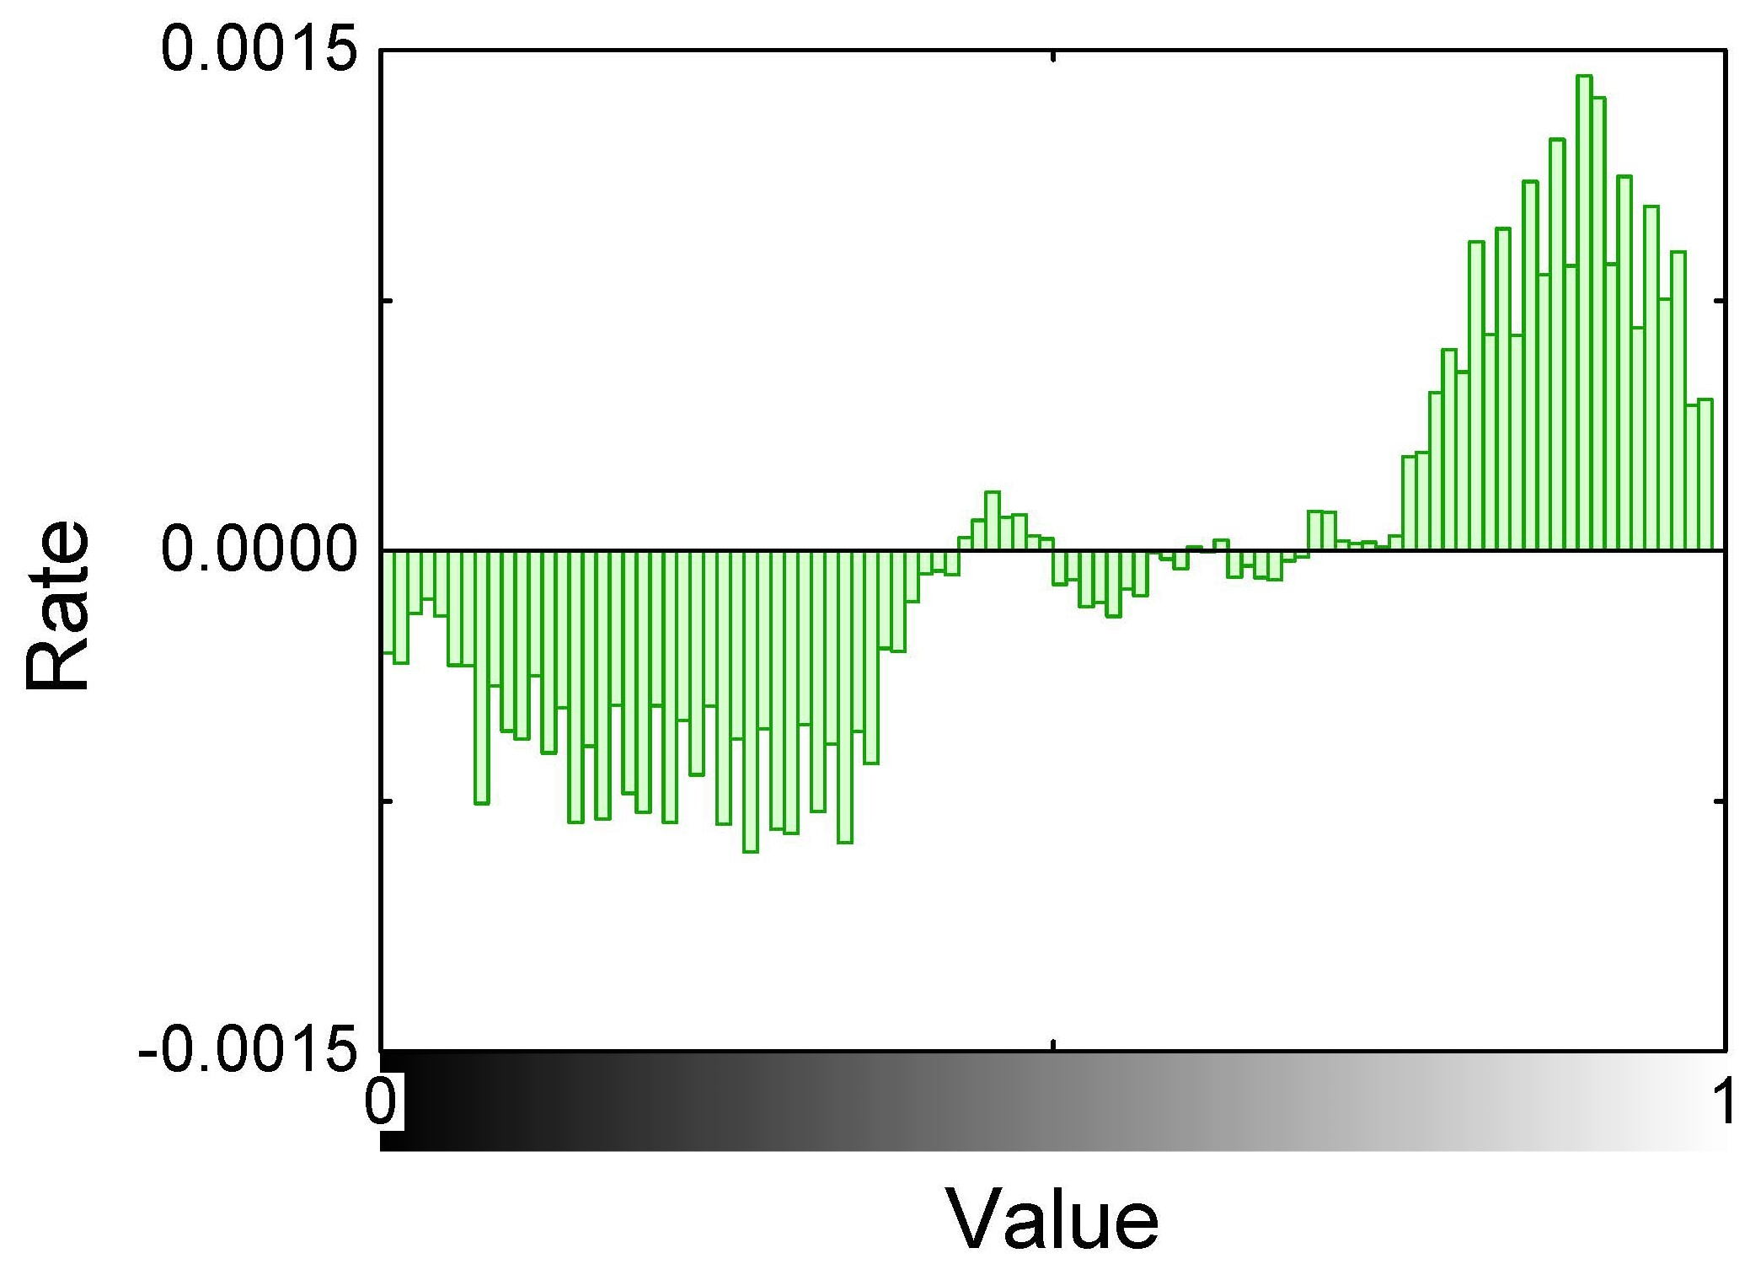
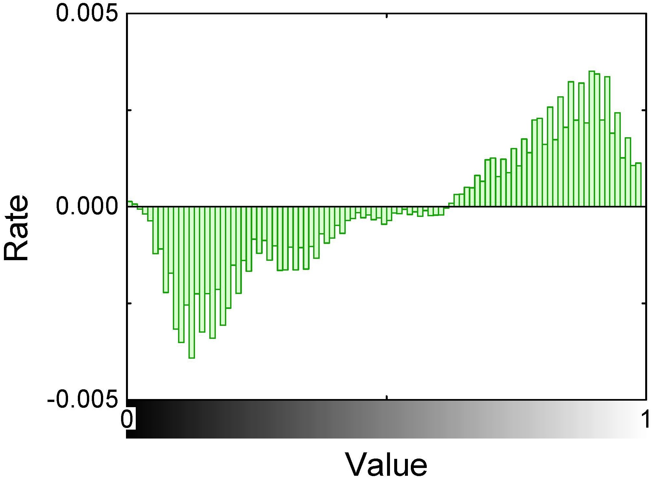
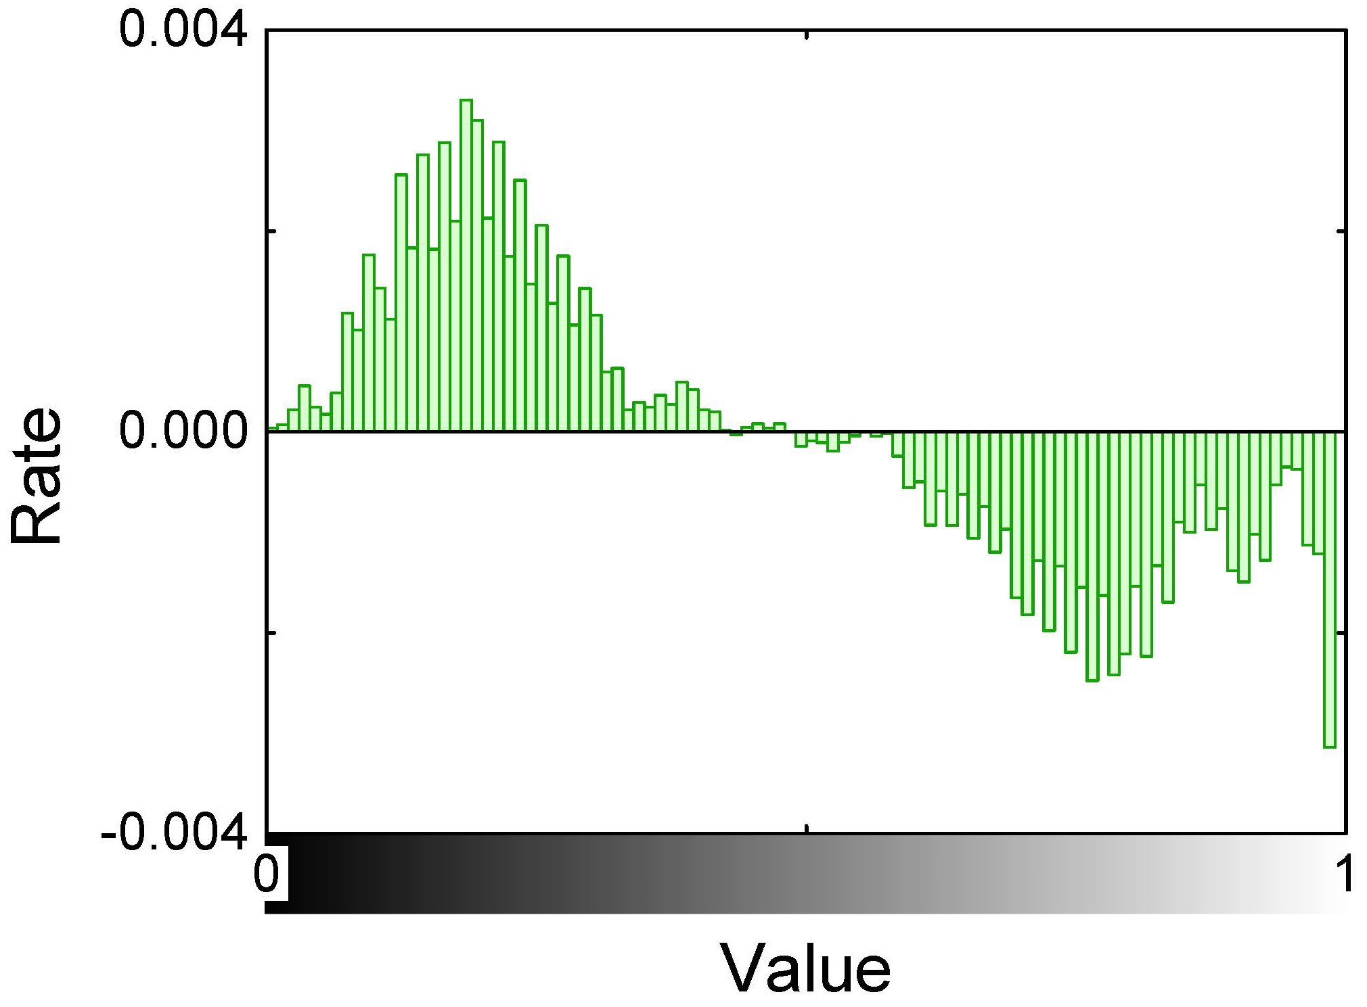
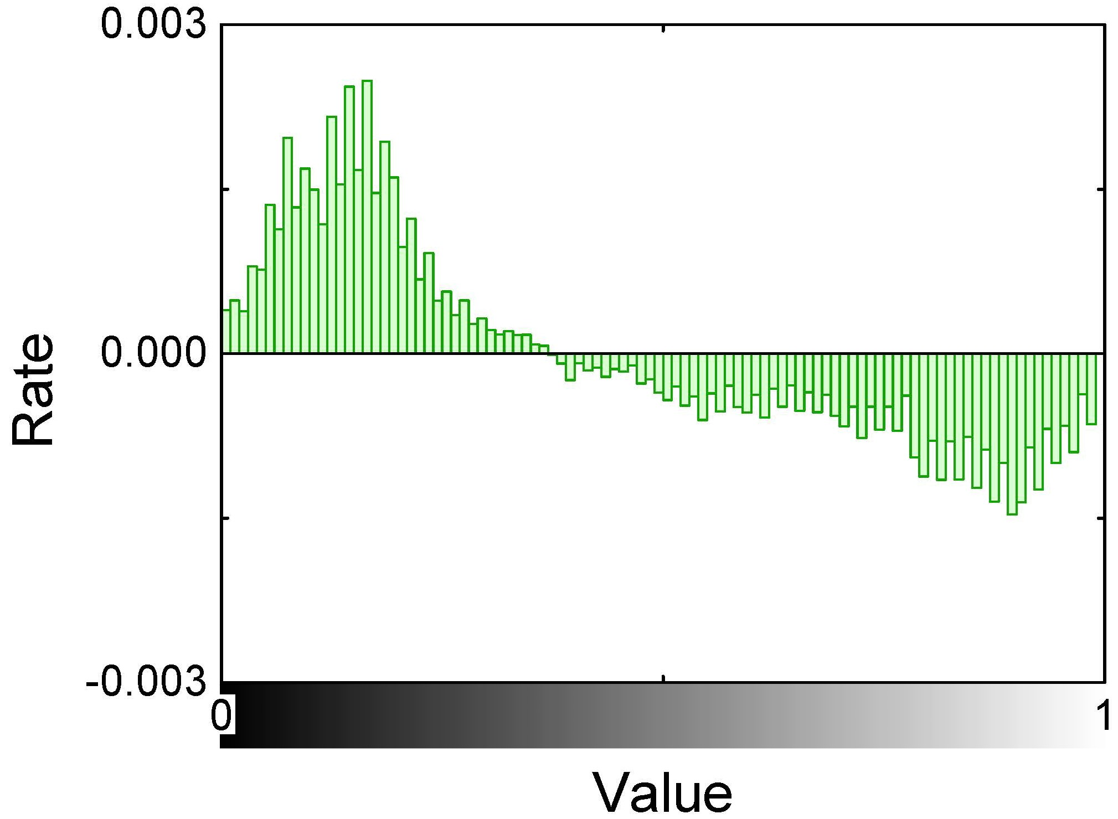
Background
Aesthetic Network
Basic Model
Hybrid Model
Experiments
Conclusion
Aesthetic preference with different time
spring summer autumn winter
People prefer bright clothes
People prefer dark clothes

Slide 17
Background
Aesthetic Network
Basic Model
Hybrid Model
Experiments
Conclusion
Time
r
A
A_{pqr}=1
if user p purchased item q
in time r
A_{pqr}=0 otherwise
1
?
?
1
User
?
?
p
1
1
Item
q

Slide 18
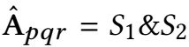
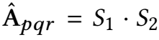
Background
Aesthetic Network
Basic Model
Hybrid Model
Experiments
Conclusion
S₁ = 1, p likes q
S₁ = 0, otherwise
S₂ = 1, q fits r
S₂ = 0, otherwise

Slide 19
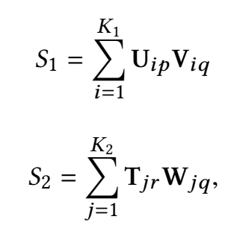
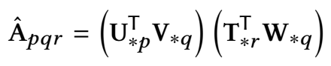
Background
Aesthetic Network
Basic Model
Hybrid Model
Experiments
Conclusion
how user p likes product q
how product q fits time r

Slide 20
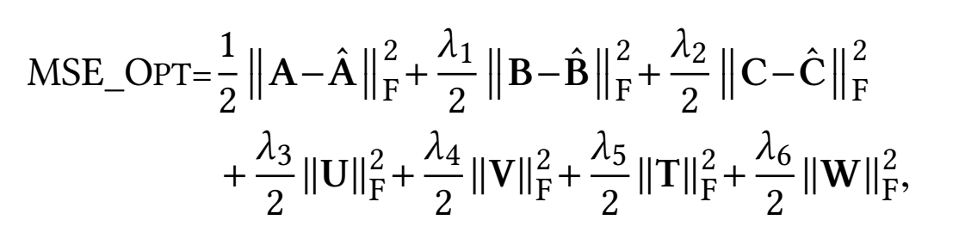

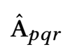
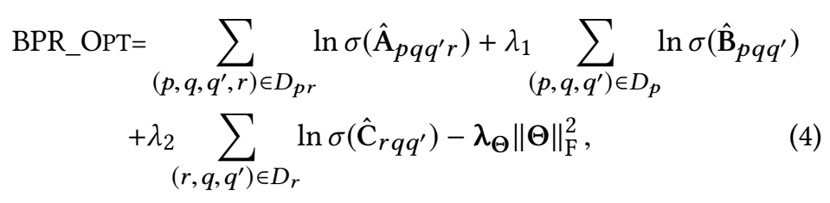
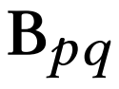
Background
Aesthetic Network
Basic Model
Hybrid Model
Experiments
Conclusion
Time
r
User
p
Item
q

Slide 21
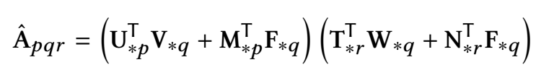
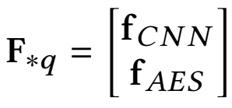
Background
Aesthetic Network
Basic Model
Hybrid Model
Experiments
Conclusion
Prediction with latent features
Prediction with visual features
Semantic information
Aesthetic information

Slide 22
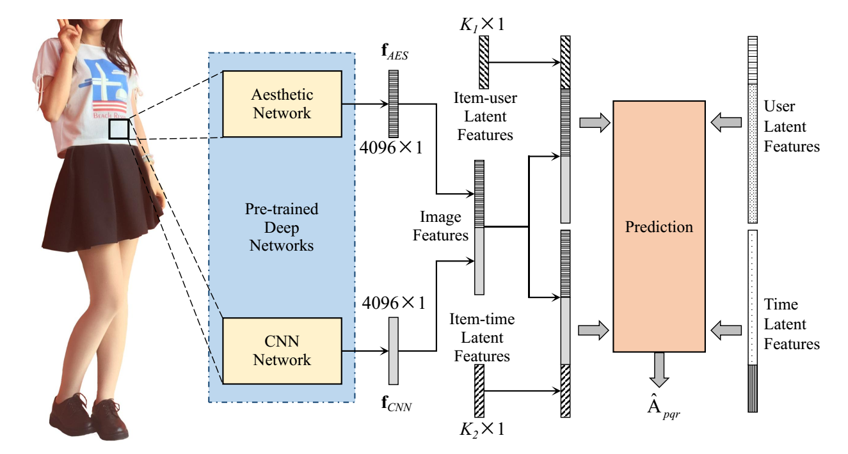
Background
Aesthetic Network
Basic Model
Hybrid Model
Experiments
Conclusion

Slide 23
Background
Aesthetic Network
Basic Model
Hybrid Model
Experiments
Conclusion
tensor data
coupled matrices
regularization
terms

Slide 24
Background
Aesthetic Network
Basic Model
Hybrid Model
Experiments
Conclusion
Research Questions:
RQ1 Performance of our model
RQ2 Superiority of the aesthetic features

Slide 25
Background
Aesthetic Network
Basic Model
Hybrid Model
Experiments
Conclusion
Performance of our model (RQ1)
Baselines
1. Random (RAND)
2. MostPopular (MP)
3. Matrix Factorization (MF)
4. CMTF Tensor factorization model trained jointly with coupled matrices
5. VBPR MF_BPR model with CNN visual features of product images

Slide 26
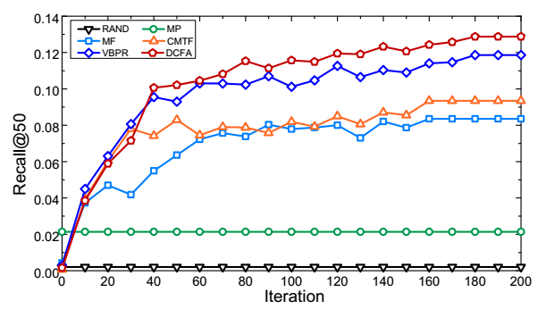
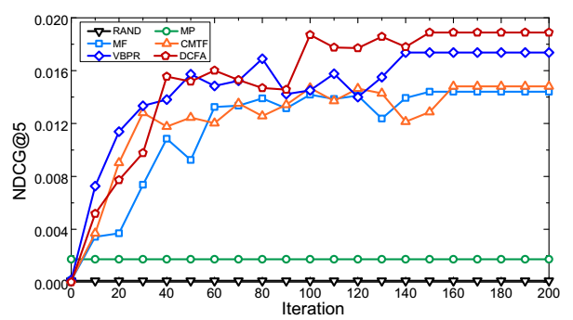

Background
Aesthetic Network
Basic Model
Hybrid Model
Experiments
Conclusion
Performance of our model (RQ1)
8.53%↑ than VPBR
8.73%↑ than VBPR

Slide 27
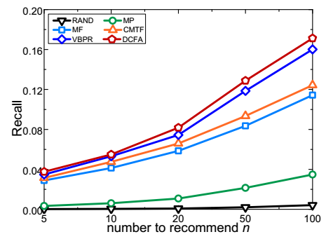
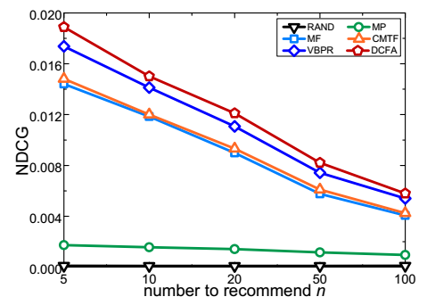
Background
Aesthetic Network
Basic Model
Hybrid Model
Experiments
Conclusion
Performance of our model (RQ1)
Recall increases with the increasing of n
NDCG decreases with the increasing of n

Slide 28
Background
Aesthetic Network
Basic Model
Hybrid Model
Experiments
Conclusion
Superiority of the aesthetic features (RQ2)
Baselines
1. DCF Basic model without features
2. DCFH Basic model with color histograms
3. DCFAo Basic model with aesthetic features only
4. DCFCo Basic model with CNN features only

Slide 29
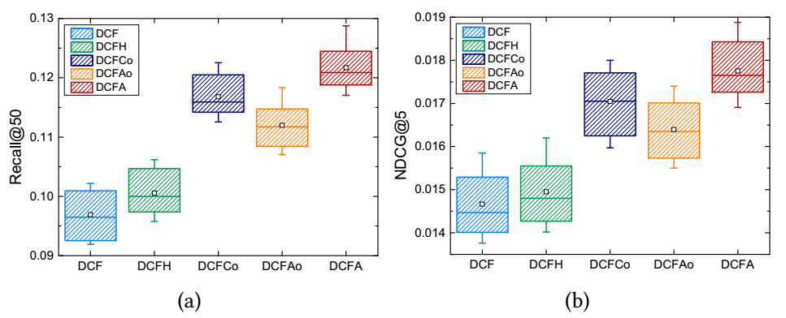
Background
Aesthetic Network
Basic Model
Hybrid Model
Experiments
Conclusion
Superiority of the aesthetic features (RQ2)
Without side information, DCF performs the worst

Slide 30
Background
Aesthetic Network
Basic Model
Hybrid Model
Experiments
Conclusion
Superiority of the aesthetic features (RQ2)
With low-level aesthetic features (color histograms) DCFH performs little better

Slide 31
Background
Aesthetic Network
Basic Model
Hybrid Model
Experiments
Conclusion
Superiority of the aesthetic features (RQ2)
With high-level features DCFAo and DCFCo performs much better

Slide 32
Background
Aesthetic Network
Basic Model
Hybrid Model
Experiments
Conclusion
Superiority of the aesthetic features (RQ2)
With semantic information and aesthetic information enhancing each other, DCFA performs the best

Slide 33
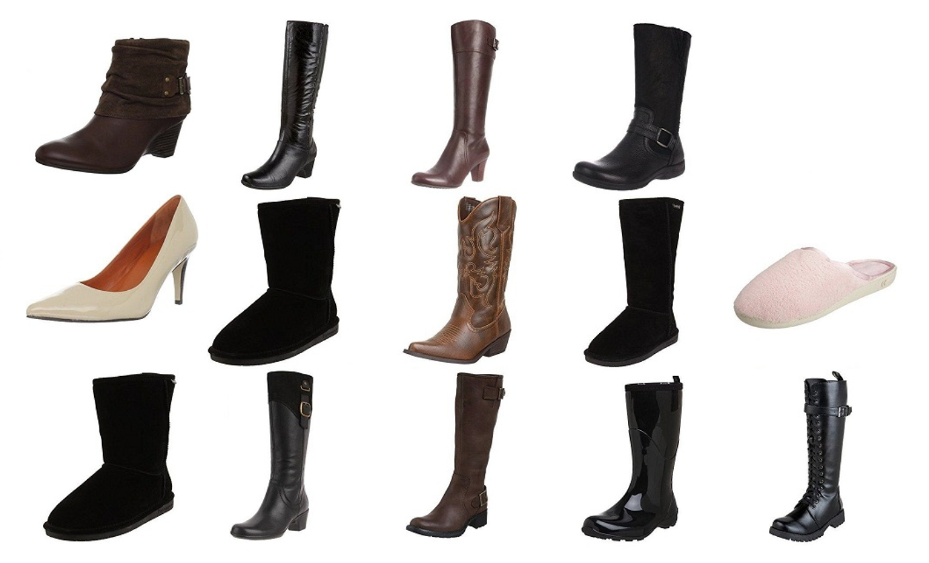
Background
Aesthetic Network
Basic Model
Hybrid Model
Experiments
Conclusion
Superiority of the aesthetic features (RQ2)
positive samples
DCFCo
（CNN only）
DCFA
(CNN & AES)

Slide 34
Background
Aesthetic Network
Basic Model
Hybrid Model
Experiments
Conclusion
Superiority of the aesthetic features (RQ2)
not boots!
positive samples
DCFCo
（CNN only）
DCFA
(CNN & AES)

Slide 35
Background
Aesthetic Network
Basic Model
Hybrid Model
Experiments
Conclusion
Superiority of the aesthetic features (RQ2)
not boots!
gaudy patterns stumpy proportion
positive samples
DCFCo
（CNN only）
DCFA
(CNN & AES)

Slide 36
Background
Aesthetic Network
Basic Model
Hybrid Model
Experiments
Conclusion
Superiority of the aesthetic features (RQ2)
leather texture
slender proportions simple design
positive samples
DCFCo
（CNN only）
DCFA
(CNN & AES)

Slide 37
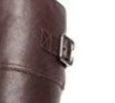
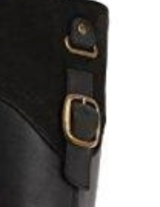
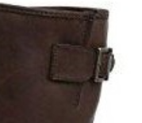
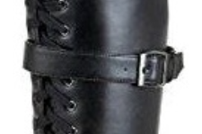
Background
Aesthetic Network
Basic Model
Hybrid Model
Experiments
Conclusion
Superiority of the aesthetic features (RQ2)
positive samples
DCFCo
（CNN only）
DCFA
(CNN & AES)

Slide 38
Background
Aesthetic Network
Basic Model
Hybrid Model
Experiments
Conclusion
We proposed a dynamic collaborative flitering model with aesthetics.
1. Explored aesthetic features for recommendation task;
2. Devised a dynamic collaborative filtering model;
3. Proposed a hybrid DCFA model.
Experiments show promising results:
1. DCFA outperforms baselines significantly;
2. With aesthetic features, DCFA can recommend the
clothes that are in line with consumer's aesthetics.

Slide 39
Background
Aesthetic Network
Basic Model
Hybrid Model
Experiments
Conclusion
Future work
1. Validate the eﬀectiveness in the setting of explicit
feedback;
2. Establish a large dataset for product aesthetic
assessment.
3. Data-driven -> knowledgement-driven

Slide 40
Thanks for listening
我们毕业啦
其实是答辩的标题地方

Slide 41
Q & A
我们毕业啦
其实是答辩的标题地方

Slide 42
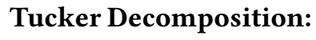
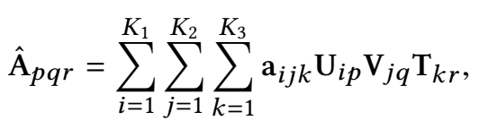
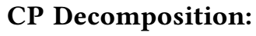
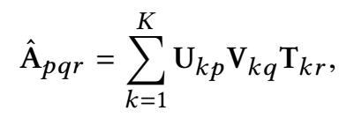
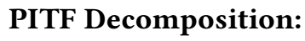
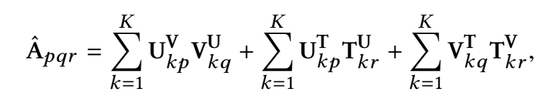
Background
Aesthetic Network
Basic Model
Hybrid Model
Experiments
Conclusion
Time
r
User
Item
q

Slide 43
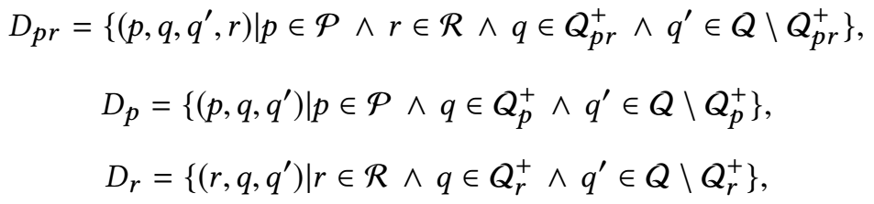
Background
Aesthetic Network
Basic Model
Hybrid Model
Experiments
Conclusion

Slide 44
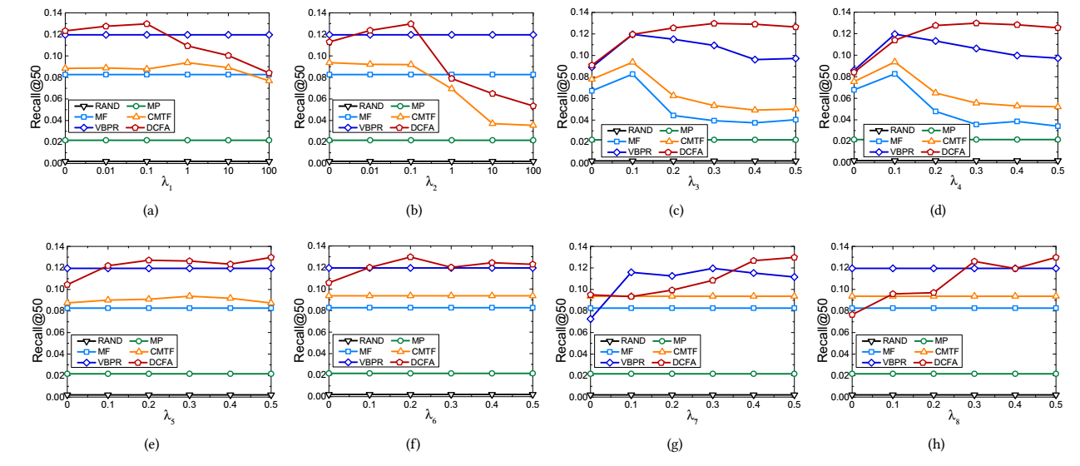
Background
Aesthetic Network
Basic Model
Hybrid Model
Experiments
Conclusion

Slide 45
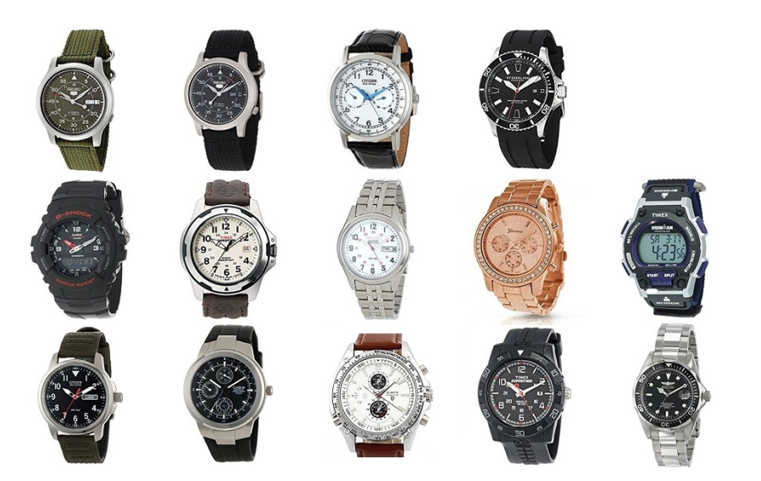
Background
Aesthetic Network
Basic Model
Hybrid Model
Experiments
Conclusion

